Slide 1
MEMEX:Detecting Explanatory Evidence for Memes via Knowledge-Enriched Contextualization
By-Sreeram Vipparla

Slide 2
INTRODUCTION
Contributions
a) A novel task, MEMEX, aimed to identify explanatory evidence for meme from their related contexts.
b) A novel dataset, MCC, containing 3400 memes and related context, along with gold-standard human annotated evidence sentence-subset.
c) A novel method, MIME that uses common sense enriched meme representation to identify evidence from the given context.
d) Empirical analysis establishing MIME’s superiority over various unimodal and multimodal baselines, adapted for the MEMEX task.
Dataset
The memes chosen from the dataset exclusively belong to the English language and are primarily focused on the Political and Historical side with the proportions for the dataset being: History (38.59%), Entertainment (15.44%), Joe Biden (12.17%), Barack Obama (9.29%), Coronavirus (7.80%), Donald Trump (6.61%), Hillary Clinton (6.33%), US Elections (1.78%), Elon Musk (1.05%) and Brexit (0.95%).

Slide 3
METHODOLOGY
a) Encoding:-
1) Text Encoder:- This component utilizes a pre-trained BERT model to encode the sentences from the provided
context(text present in the meme).
2) Multimodal Encoder:- This encoder takes the meme itself (both the image and the related text) and encodes it using
a multimodal encoder.
b) Knowledge Enriched Meme Encoder (KME):- Using a pre-trained GCN, trained using ConceptNet, the aim is to incorporate the semantic characteristics by extracting the averaged GCN-computed representations corresponding to the meme’s text.
c) Meme-Aware Transformer (MAT):- This facilitates the integration of multimodal meme information while computing the self attention over context representations.
d) Meme-Aware LSTM (MA-LSTM):- It is a recurrent neural network that incorporates the meme representation while computing cells and hidden states. The gating mechanism allows it to assess how much information it needs to consider from the hidden states of the enriched context and meme representations. The hidden states from each time step are then concatenated to produce the unified context representation
NOTE: Context Representation:- Given a related context, C consisting of a collection of sentences [c1, c2...cn], each sentence in C is encoded individually using a pre-trained BERT encoder, and the pooled output corresponding to the [CLS] token is used as the context representation. Finally, each individual sentence representation is concatenated to get a unified context representation.

Slide 4
ADVANTAGES
1) Extensive performance analysis and comparison of MMBT with various unimodal and multimodal models.
2) The proposed model is comprehensive and provides an innovative solution to find the context in the memes.
3)The dataset is original and has been annotated by professionals. This can support more complex analysis and better results.

Slide 5
DISADVANTAGES
1) Since, the model is complex and computationally expensive.
2) The model is unable to perform complex level of abstractions that a meme exhibits, leading to incorrect predictions or partial correct predictions.
3) The MIME framework may not fully handle the process of getting the hidden meaning of a meme and combine it with factual knowledge.

Slide 6
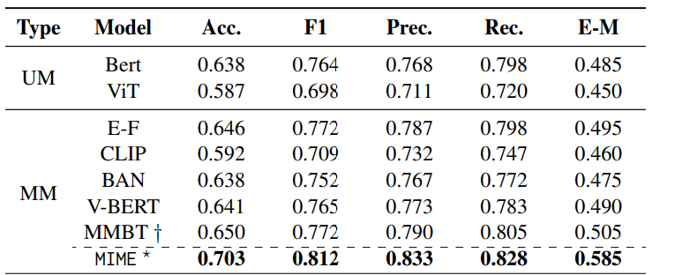
RESULTS
Unimodal Baselines: 1) BERT 2)ViT
Multimodal Baselines: 1) Early-fusion(BERT+ViT) 2) MMBT 3) CLIP 4) BAN 5) VisualBERT
From the results it is evident that MIME outperforms each of the unimodal and multimodal baselines in every category consisting of Accuracy, F1, Precision, Recall and E-M score.

Slide 7
IMPROVEMENTS
1) In the step regarding the encoding with BERT and then concatenating the sentences, the model might not capture the inter-dependencies between them, so it would be better to find a different way of encoding the text.
2) Improvements can be made to the architecture to make it light weight as it is presently computationally expensive.
3) Its limitations include biases in which we can potentially use adversarial training techniques where the model is exposed to synthetic data with intentionally introduced lexical biases, this can help the model learn to be more robust to such biases in real-world data.

Slide 8
THANK YOU

